Slide 1


Hii,
Iam Siddhika
Welcome to Power BI Series
Part -38

Slide 2



Today Content
We focus only on the most used and important Dax Functions
I’m soo Excited.
Are you ready guys?
Meet DAX
COMMON FUNCTION CATEGORIES
5.TABLE MANIPULATION FUNCTIONS(FEW MORE)
SUMMARIZECOLUMNS
COMPARING SUMMARIZE AND SUMMARIZECOLUMNS SELECTCOLUMNS

Slide 3

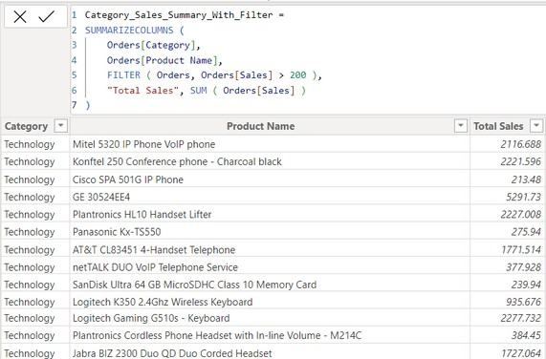

SUMMARIZECOLUMNS
SUMMARIZECOLUMNS groups data by one or more columns, allows for filtering data within the function, and can create additional columns with calculations based on these groups.
Check next
Example also
Syntax
SUMMARIZECOLUMNS( <groupBy_columnName> [, < groupBy_columnName >]…, [<filterTable>]…[, <name>, <expression>]…)
Here just i’m taking for example to understand.
_{Example} Suppose you want to create a summary table of total sales by category and product name. but only include orders where the sales amount is greater than $200.
Orders[Category] and Orders[Product Name] Columns to group by.
FILTER(Orders, Orders[Sales] > 200) Filter to include only rows where the Sales amount is greater than $200. "Total Sales" Name of the new column that will hold the summarized sales value.
SUM(Orders[Sales]) The expression to calculate the total sales for each category and product name.

Slide 4
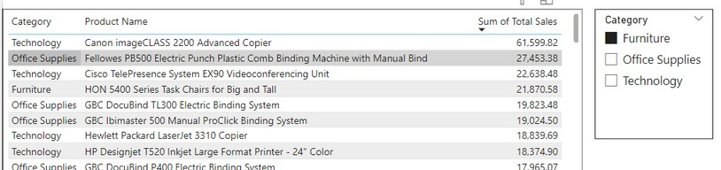

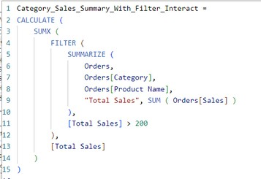
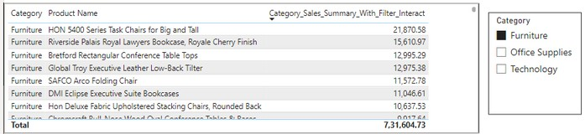

When you create a summary table using the SUMMARIZECOLUMN function in DAX, the resulting table itself does not automatically interact with filters from other tables. However, the measures and visuals you create using this summary table can still interact with filters, provided the relationships in your data model are properly set up.
Same as SUMMARIZE
Function
You can use SUMMARIZECOLUMN within another DAX function like SUMX to create a measure that interacts well with other table filters.
Let's continue with the same Orders table example to create a measure that calculates total sales by category, Product Name and interacts with filters:
SUMMARIZE creates a summary table with the specified columns and calculates the total sales for each category and product name. FILTER filters the summarized table to include only rows where the total sales are greater than 200.
SUMX iterates over each row of the filtered summarized table and sums up the total sales.
CALCULATE wraps the entire expression, allowing it to interact with filters from other tables or visuals in your Power BI report.

Slide 5
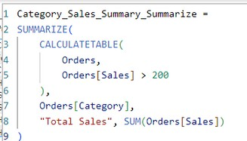

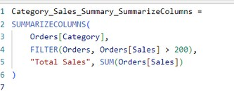
Comparing SUMMARIZE and SUMMARIZECOLUMNS
SUMMARIZECOLUMNS: Allows for filtering directly within the function, making it more concise and often easier to read.
SUMMARIZE: Requires an additional CALCULATETABLE function to apply filters, making the syntax more complex and less intuitive.
Understood?
Scenario: Summarize Total Sales by Category with a Sales Filter (> 200)
Using SUMMARIZE:
First, we need to apply the filter using a CALCULATETABLE function because SUMMARIZE does not support inline filtering.
Using SUMMARIZECOLUMNS:
Inline filtering is directly applied within the function.
Performance:
SUMMARIZECOLUMNS: Generally more optimized for performance, especially with complex filtering and large datasets.
SUMMARIZE: Can be less efficient as it requires external filtering, which might lead to more computational overhead.
Simplicity and Readability:
SUMMARIZECOLUMNS: More straightforward for scenarios that involve filtering, as it combines grouping and filtering into a single step.
SUMMARIZE: Requires separate steps for filtering and summarizing, which can be more verbose and harder to maintain.

Slide 6

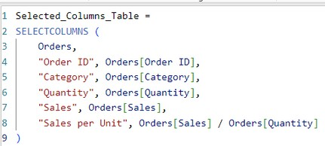
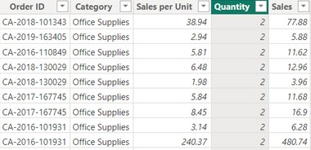
SELECTCOLUMNS
The SELECTCOLUMNS function in DAX is used to create a new table by selecting and renaming specific columns from an existing table. This function is helpful when you want to reshape your data, focus on specific columns, or create calculated columns directly in a new table.
Check
next
Syntax
SELECTCOLUMNS(<Table>, [<Name>], <Expression>, <Name>], …)
Create a new table that includes the Order ID, Category,Quantity and Sales columns, and adds a new column called Sales per Unit which is calculated as Sales / Quantity.
Orders This is the original table from which you're selecting columns.
"Order ID", Orders[Order ID] This line selects the "Order ID" column from the Orders table and renames it to "Order ID".
Example
"Category", Orders[Category] Similarly, this line selects the "Category" column.
"Quantity", Orders[Quantity] This line selects the "Quantity" column.
"Sales", Orders[Sales] This line selects the "Sales" column.
"Sales per Unit", Orders[Sales] / Orders[Quantity]: This line creates a new column named "Sales per Unit" by dividing the "Sales" column by the "Quantity"
column for each row.

Slide 7
Understanding difference of ADDCOLUMNS and SELECTCOLUMNS
SELECTCOLUMNS
Purpose: SELECTCOLUMNS is used to create a new table by selecting specific columns from an existing table and optionally renaming them. It allows you to choose and rename columns from an existing table to create a new table structure.
Usage: You use SELECTCOLUMNS when you want to reshape your data or create a subset of columns from an existing table.
Example: Selecting only certain columns from a table to reduce complexity or expose only relevant information.
ADDCOLUMNS
Understood?
Purpose: ADDCOLUMNS is used to add new columns to an existing table by specifying column names and expressions to calculate their values. It creates a new table with additional columns based on calculations performed on existing columns.
Usage: Typically, you use ADDCOLUMNS when you want to add calculated columns to an existing table.
Example: Adding a new column to calculate profit margin based on existing columns like sales and cost.

Slide 8


Thank you for joining me today to learn about Part -38 of Power BI!
Remember, Learning DAX is key to unlocking the full potential of Power BI for insightful reporting and visualization.
Stay tuned for more insights and tips on Power BI in our next Series.
Follow
Siddhika Shah

